Slide 1
Collections Part 2
Module 1: 08

Slide 2
Objectives
Set<T>
Map<T, T>
Algorithm Complexity (if there is time)

Slide 3
Set<T>
Elements are not ordered
Elements in the set must be unique
Adding a duplicate does nothing
Cannot access elements by index, only by iterator (for each)
add( x ) adds element to the set
Set<T> variable = new HashSet<T>();
Set - Set interface <T> - Data Type the Set will Hold HashSet - implementation class
Set<Integer> setOfNumbers = new HashSet<Integer>();

Slide 4
Set Order
The Order of the elements in a Set can be controlled by the Implementation Class used.
HashSet Set<String> s = new HashSet<String>();
Does not guarantee Order
Allows null
LinkedHashSet Set<String> s = new LinkedHashSet<String>();
Order of Insertion
Allows null
TreeSet Set<String> s = new TreeSet<String>();
Natural Order of Data Type
Does not allow null
Natural Order of numeric types is numeric order:
1, 2, 10, 20, 21, 30
Natural Order of String is alphanumeric order:
1, 10, 2, 20, 21, 30

Slide 5
Key Value Pairs
A set of 2 pieces of data, where the value is associated by a unique key, allowing the value to be retrieved by providing the key.
key=value
Key value pairs are commonly used in development, allowing the developer to assign a key to a value so that value can later be retrieved by that key.
Key Value Pairs in real life
City lookup by zip code
43220 → Columbus, OH
90210 → Beverly Hills, CA
Phone book
867-5209 → Jenny
719-266-2837 → Callin Oats
Vending Machine
A1 → Snickers Bar
B2 → Potato Chips

Slide 6
Map<T, T>
A map is a collection that utilizes Key Value Pairs, allowing values to be assigned and then located using user-defined keys.
Collection of Keys and a Collection of Values that are organized such that the value can be retrieved using the key.
Indexed by the key rather than order, allowing for very fast retrieval of a specific value.
Map Keys
Can be any reference type
Must be unique
Cannot be null
Stored as a Set
Map Values
Can be any reference type
Can have duplicates
Can be null

Slide 7
Creating a Map<T, T>
The Data Type of the Key and the Value are not related, and do not need to be the same.
<Integer, Double>
<Integer, House>
<String, String>
<Character, Boolean>
Map<T, T> variable = new HashMap<T, T>();
Map - Map Interface <T, T> - the first Type is the Data Type of the Key <T, T> - the second Type is the Data Type of the Value HashMap - the implementation class to instantiate
Map<String, Integer> inventory = new HashMap<String, Integer>();

Slide 8
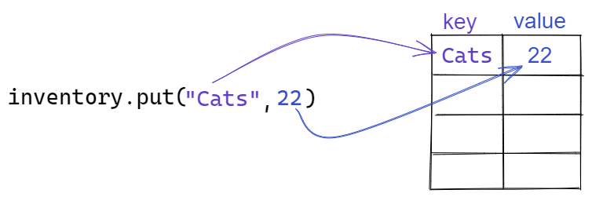
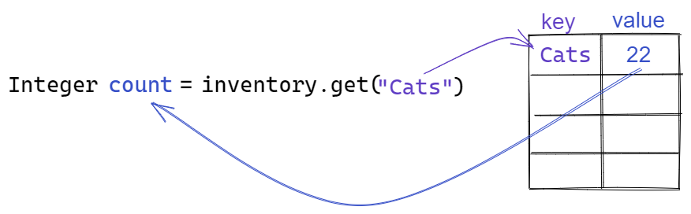
Add and Getting Map Elements
Map<String, Integer> inventory = new HashMap<String, Integer>();

Slide 9
Map Methods
.put( key, value ) | Adds or Updates the value in the Map. If the key does not exist it adds the key and the value.
.get( key ) | Returns the value associated with the given key. If the key does not exist null is returned.
.remove( key ) | Removes a key/value pair from the map. If the key exists the value is returned, otherwise null is returned
.containsKey( key ) | Returns true if the key exists in the map
.containsValue( value ) | Returns true if the value exists in the map
.keySet() | Returns all the keys in the map as a Set<T> collection
.entrySet() | Returns all Key/Value pairs as Entry<T, T> objects
Visual Explanation

Slide 10
Looping over a Map with keySet()
keySet() returns the keys in the map as a Set<T>, which can be used in a for each loop and then used to get the value.
Map<String, Integer> inventory = new HashMap<String, Integer>();
for ( String key : inventory.keySet() ) {
Integer value = inventory.get( key );
}

Slide 11
Looping over a Map with entrySet()
entrySet() returns the key value pairs in the map as a Set<Entry<T, T><, which can be used in a foreach loop.
Map<String, Integer> inventory = new HashMap<String, Integer>();
for ( Entry<String,Integer> nextEntry : inventory.entrySet() ) {
String key = nextEntry.getKey(); Integer value = nextEntry.getValue();
}

Slide 12
Map Order
How a map orders data is dependent on the implementation class used.
HashMap does not maintain order.
Map<T, T> map = new HashMap<T, T>();
LinkedHashMap maintains the order of insertion.
Map<T, T> map = new LinkedHashMap<T, T>();
TreeMap maintains the natural order of the Key Data Type.
Map<T, T> map = new TreeMap<T, T>();
Natural Order of numeric types is numeric order:
1, 2, 10, 20, 21, 30
Natural Order of String is alphanumeric order:
1, 10, 2, 20, 21, 30
Map JavaDoc for Java 8

Slide 13
Algorithm Problems
 | Simple Search | Binary Search
100 Elements | ~100ms | 7ms
10,000 Elements | expected: ~210ms actual: 10 seconds | 14ms
1,000,000,000 Elements | expected: ~480ms actual: 11 days | 32ms

Slide 14
Algorithm Complexity
Algorithms are not measured by the speed they run, but by how their performance increases as the problem sizes increases.
Big O notation is used to describe an algorithms change in performance as the problem size increases.
Big O and complexity is always measured in the Worst Case Scenario.

Slide 15
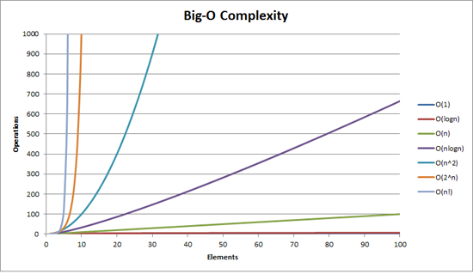

Slide 16
Big O Complexities
O(1) | Constant-time | The complexity doesn’t increase as the problem increases. Selecting an item from an Array by index.
O(log n) | Logarithmic | The complexity increases at a constant factor that is not directly related to the problem size.
O(n) | Linear | Doubling the problem size, doubles the complexity Iterating over every item in a list
O(n log n) | Linearithmic | Doubling the problem increases the complexity by a fixed size. Most search algorithms
O(n²) | Quadratic | Doubling the problem size multiplies the complexity by a factor of 4 Loop within a Loop
O(n^{x}) | Polynomial | Double the size of the problem multiplies the complexity by a factor multiplied by the exponent
O(2^{n}) | Exponential | Increasing the problem size by 1 double the complexity. Doubling he problem size squares the work.
O(n!) | Factorial | Something has gone horribly wrong

Slide 17
Collection Complexity
Each collection time has a complexity associated with
Insert (at end, at beginning, at end)
Searching
Retrieval
Removal (from end, from beginning, from end)
Table of Collection Complexities

Slide 18
It is ALWAYS more important to find a correct solution first. Only after a problem is solved should it be looked at for performance improvements.
Never Optimize First, only at the end

